Slide 1
TnP Project(Adv Python)
Presented by – Rakshit Vyas
Class – 6B
Enrollment no – 0103CS181115

Slide 2
QuizApp
My Awesome Cart is a Ecommerce website with all the functionality of a Ecommerce website along with a blog section.
Github link - https://github.com/rkvyas98/myawesomecart/

Slide 3
Abstract
Electronic Commerce is process of doing business through computer networks. A person sitting on his chair in front of a computer can access all the facilities of the Internet to buy or sell the products.
E-Commerce was started in early 1990’s and has taken a great leap in the world of computers.
The main advantage of e-commerce over traditional commerce is the user can browse online shops, compare prices and order merchandise sitting at home on their PC.

Slide 4
What is E-Commerce ?
Commonly known as electronic commerce or eBusiness.
E-Commerce is used for buying and selling products and services over the internet.
It covers a range of different types of businesses, from consumer based retail sites, through auction or music sites, to business exchanges trading goods and services between corporations.

Slide 5
ADVANTAGES OF E-COMMERCE
Faster buying/selling procedure, as well as easy to find products.
Buying/selling 24/7.
More reach to customers, there is no theoretical geographic limitations.
Low operational costs and better quality of services.
No need of physical company set-ups.
Easy to start and manage a business.

Slide 6
DISADVANTAGES OF E-COMMERCE
Unable to examine products personally.
Not everyone is connected to the Internet.
There is the possibility of credit card number theft.
Mechanical failures can cause unpredictable effects on the total processes.

Slide 7
REQUIREMENT SPECIFICATIONS
HTML
CSS
Bootstrap
JavaScript, jQuery
Python
Django
Visual Studio Code
Hosted on Local host
SQLite Database

Slide 8
Pages and Features
Home Page - Contains all the products, Cart, Search Products.
Product Page - Contains all the information of the products.
Checkout Page – Contains all the information of the cart and form for product delivery.
Tracker – Contains form to track the products.
Blog Page - Contains all the blog posts
About Us - Contains brief content about the E-commerce website.
Contact Us – Contains a Form to contact us.

Slide 9
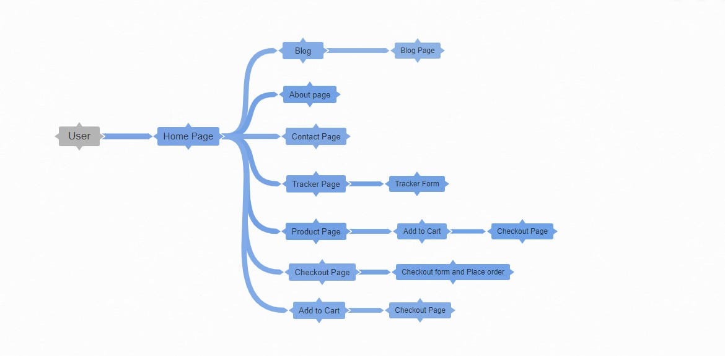
Data flow Diagram

Slide 10
Future plan
I have some advanced idea and modifications which can be implemented in the system. Some of them are –
GUI modification (more user friendly).
Users can signup / login.
Users can sell their products.
Applying ML for Product recommendation system.

Slide 11
Thank you!

